Slide 1
Housekeeping
WiFi
Mars
Click sign up and use john.armstrong@solnetsolutions.co.nz
Toilets
Males code - c12x
Females code - c12y
Food and drink in kitchen (only)
All this can be found here (plus extras like tutorials)
http://bit.ly/2bvDt7P
Agenda
Start with presentation
Get into tutorials
Have pizza!

Slide 2
Who am I
John Armstrong
Github: jman48
Email: j.armstrong484@gmail.com
Software Engineer at Solnet
Did SoT 2 years ago

Slide 3
Solnet

Slide 4

AngularJS (2.0)
Superheroic JavaScript framework

Slide 5
What it is
Open source JavaScript framework used for building web applications (not just web pages).
The most popular JS framework (by far)
Component based framework
From Google

Slide 6
Why
Create web apps not web pages
Use across all platforms (web, native mobile and desktop)
Separation of concerns
Enhances HTML (directives, templates, expressions…)
Built for testability (Jasmine, Karma, Protractor…)
Helps with JavaScript nuisances (XHR, routing, data binding…)
Fast (some say 10X Angular 1)

Slide 7
Concepts - Web Components
It is a way to package all the style and functionality into a reusable component.
Custom Elements
Templates - HTML
Functionality - JavaScript
Styling - CSS
E.g HTML range selector
App made from multiple components (some nesting involved)
Shadow DOM
Can encapsulate everything into the component
Control what other devs can use

Slide 8
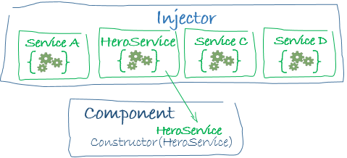
Concepts - Dependency Injection
Ask for things instead of creating them directly
Great for mocking in unit tests as we can mock what a service returns. E.g backend calls
Done in Angular using the injector
Injector keeps a pool of services and creates them when they are needed

Slide 9
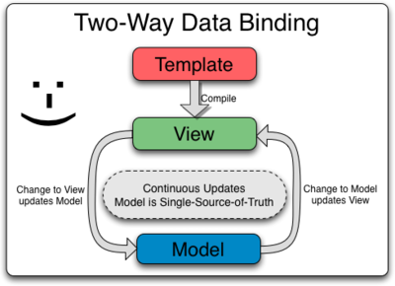
Concepts - Data Binding
Mechanism to bind JS values with your view
Can be one-way or two-way
One-way binding
Updates to view will change JS value OR
Updates to JS value will change view
Two-way binding
Updates to view will change the object AND
Updates to the object will be shown in the view

Slide 10
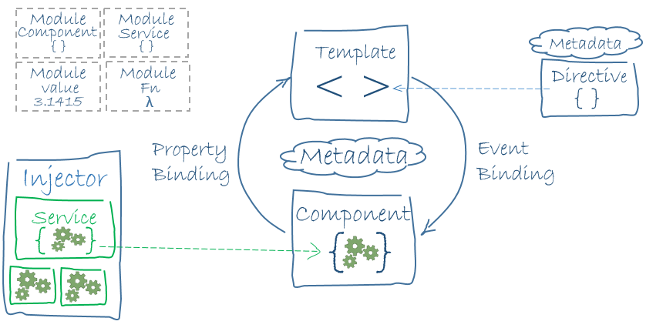
A little from AngularJS team
We write Angular applications by composing HTML templates with Angularized-markup, writing component classes to manage those templates, adding application logic in services, and boxing components and services in modules.

Slide 11
How - TypeScript
A typed superset of JavaScript (compiles down to plain javascript).
AngularJS 2 is built using TypeScript and you can use it too!
Types:
String (var name: string = ‘John’;)
Number (var age:number = 2;)
Array (var items: string[] = [‘milk’, ‘cheese’];)
Any (var something: any = ‘100km’;)

Slide 12
How - TypeScript Classes
Example of classes, functions and typed parameters (Much like Java or C#)
class person {
name: string;
age: number;
constructor(name: string, age: number) {
this.name = name;
this.age = age;
}
sayHello(): string {
return 'Hello ' + this.name;
}
}

Slide 13
How - TypeScript Decorators
A cool way to define meta data on classes.
Helps separate concerns
@Component({
selector: 'my-app',
template: '<h1>Hello World</h1>'
})
class person {
name: string;
age: number;
…

Slide 14
How - Components
A component is a class with a template
Basically a class that represents an element on the screen
The class of the component is shared with its view
Main building blocks of an Angular 2 web app
Define using @Component decorator

Slide 15
How - Component
@Component({
selector: 'my-app',
template: '<h1>Hello World</h1>'
})
class person {
name: string;
age: number;
constructor(name: string, age: number) {
this.name = name;
this.age = age;
}
sayHello(): string {
return 'Hello ' + this.name;
}
}

Slide 16
How - Directives
Basically a component without a template
Used to add functionality to other components
Use for all DOM manipulation
Can create your own
Can add them to any HTML element
E.g Highlight green on focus, hide an element...

Slide 17
How - Directives (some cool ones)
Angular has some built in directives
ngModel
Binds view and JS object together
<input [(ngModel)]="userInput" type="text"/>
ngIf
Add or remove element
<h1 *ngIf="age < 18">You can not view this</h1>
ngFor
Loop over a collection, creating attached element for each item
<li *ngFor="let item of items">{{item}}</li>
ngClass
Conditionally apply a class
<div [ngClass]="{error: invalid()}">Status</div>

Slide 18
How - Templates
Your uncompiled view for your component
Tells Angular how to render a component
Uses Angularised markup (basically HTML with some Angular functionality)
Can be a string or a url to a template file

Slide 19
How - Template Syntax
To bind to events use (event)=”code to run” and pass it the function we want to execute
<button (click)="sayHello($event)">Say Hi</button>
Expression evaluation use {{expression}}. Will replace it with the string version of the outcome of the expression
<p> My name is {{name}}</p>
<p>The sum of 1 + 1 is {{1 + 1}}</p>

Slide 20
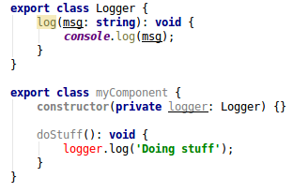
How - Services
Should hold all application logic and common functionality between components
Keep components lean
Add them through dependency injection
Examples
Backend requests
Validation
Logging

Slide 21
How - Modules
A way of breaking down an application into logical parts and only importing the parts you need
Is a class with the @NgModule decorator
import { Component } from '@angular/core';
import { BrowserModule } from '@angular/platform-browser';
import { FormsModule } from '@angular/forms';
export class todoComponent { }

Slide 22
A little from AngularJS team
We write Angular applications by composing HTML templates with Angularized-markup, writing component classes to manage those templates, adding application logic in services, and boxing components and services in modules.

Slide 23
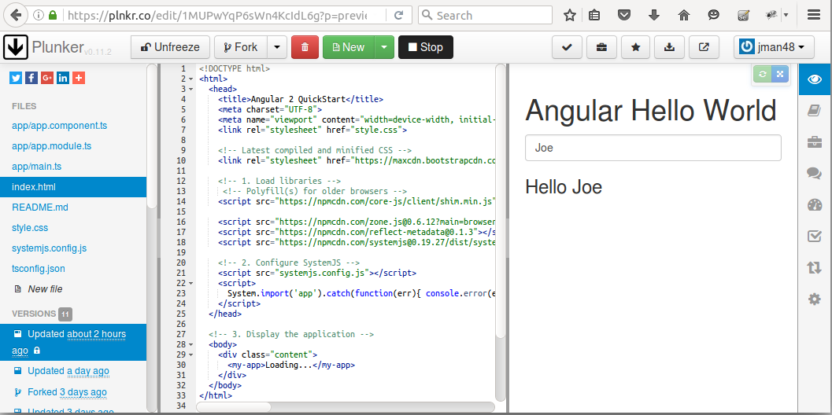
Plunker
Online JavaScript editor.

Slide 24
Tutorials
I have set up some tutorials to help reinforce the concepts you have learnt here. Can start them now and finish them when you want. They will be up indefinitely
Tutorial 1 - Easy
Start - http://bit.ly/2bQc3fV
Complete - http://bit.ly/2bwl5wn
Tutorial 2 -Medium
Start - http://bit.ly/2bKUxuo
Complete - http://bit.ly/2bvOC8P

